Slide 1

Social Buzz Activity Insights about User Engagement and Interest
TITLE
DATE: 28th, May 2024.
Presented by: Omolola Agosu, Andrew Fleming, Marcus Rompton

Slide 2


Today's agenda
Project recap
Problem Statement
The Analytics team
Analysis Process
Insights
Summary

Slide 3


Social Buzz have grown faster than expected and require an advisory firm to manage their scaling process efficiently. In essence, we are undertaking a three-month pilot project to showcase our company's expertise to start our collaboration with Social Buzz. Our deliverables are:
Project Recap
A comprehensive audit of their big data practices
Strategic recommendations for a successful IPO
An analysis of content categories identifying the top 5 categories with the highest overall popularity

Slide 4

Problem Statement
500 million active monthly users
More than 100,000 unstructured data items are generated every day.
Which categories of these contents appeal to its audience the most?
The goal is to determine which top 5 content categories are the most popular for improved interaction and direct future content production.

Slide 5



Andrew Fleming
Chief Technology Architect
The
Analytics
team
Marcus Rompton
Senior Principal
Omolola Agosu
Data Analyst

Slide 6
Process
1
Data Collection
2
Data cleaning
3
Data modeling
4
Analysis
5
Uncover Insights

Slide 7
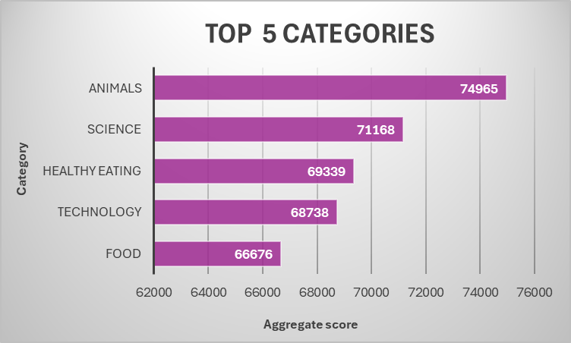

Insights
The top five content categories that have gained the most overall popularity beginning from the highest are :
Animals-74,965 score
Science-71,168 score
Healthy Eating-69,339 score
Technology-68,738 score
Food-66,676 score

Slide 8
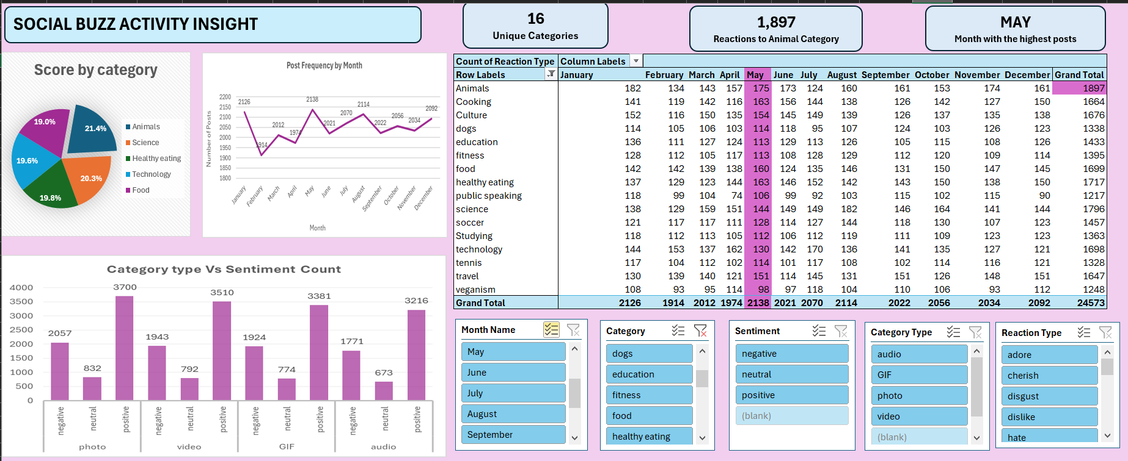
Insights

Slide 9
Insights
16
Unique Categories
1,897
Reactions to animal category
May
Month with the highest posts

Slide 10

ANALYSIS & INSIGHTS
Animals, Science, Healthy eating, Technology and Food ranked as top 5 but with 1,897 reactions, the Animals category had the most engagement and was the most popular. This demonstrates how engaged and interested users are in animal-related information.
May has the highest volume of posts: this is a high month for user engagement, which could be due to various reasons like special promotions, seasonal events, seasonal trends or public holidays.
The majority of sentiments are positive (13,807), with negative (7,695) and neutral (3,071) following closely behind.
With a score count of 6589, photos are the most engaging category type. Videos are next with a score count of 6245; GIF and audio are the next two in that order.
WHAT TO DO NEXT:
It will be encouraged to use popular categories with the objective of creating more high-quality and visually appealing images and videos for those categories. Aim for May's Peak Engagement by posting interesting content and implementing promotions.
Our team is available to support you in refining these strategies using data, including how to maintain a great user experience, optimize engagement, and profit from user patterns.
Summary

Slide 11
Thank you!
ANY QUESTIONS?

